Slide 1

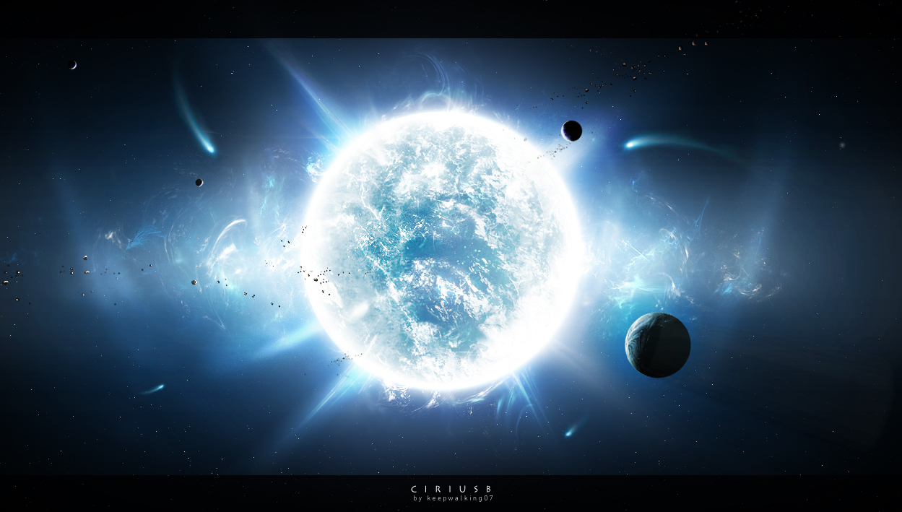
Discovering
Stellar
Secrets

Slide 2
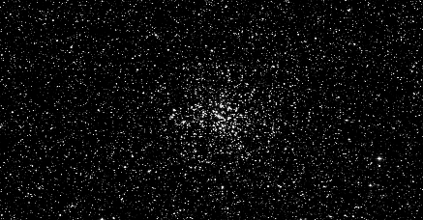
M37 Through The Telescope
M37 contains about 500 stars, is 10,000 years old and located 4,400 light years away.

Slide 3
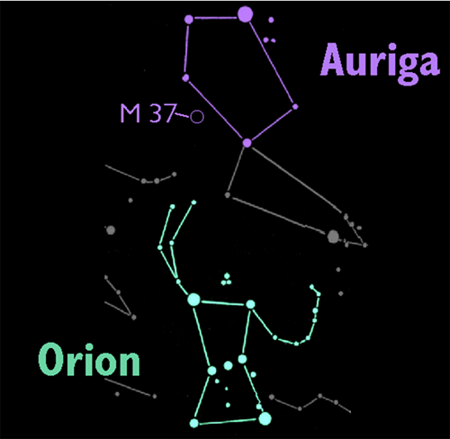
M37 in the Night Sky
M37 is in the constellation Auriga, "The Charioteer".

Slide 4
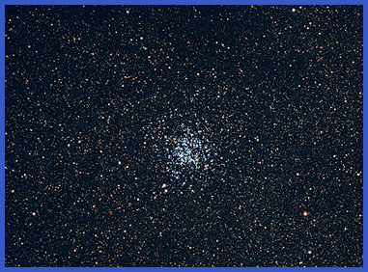
Open Clusters of the Milky Way
Open clusters are groups of stars, that formed from a single large cloud of interstellar gas and dust.
They contain a few hundred to a few thousand stars.

Slide 5
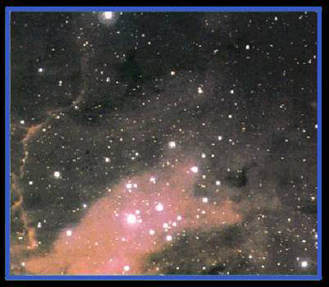
Open Clusters of the Milky Way
The youngest of our galaxy’s open clusters are still veiled in the dense clouds of gas and dust from which they are forming.

Slide 6
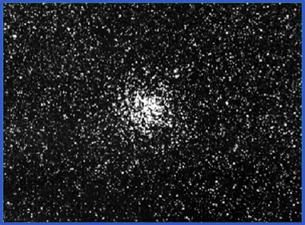
Open Clusters of the Milky Way
“Mature” open star clusters have used up all of their gas forming new stars.
For a few million years the stars of the newly formed cluster will stay together in space but eventually will drift apart.

Slide 7
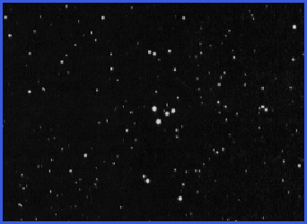
Open Clusters of the Milky Way
Because the stars are only weakly held together by gravity, they will eventually drift apart.
This smattering of stars was once an open cluster.

Slide 8
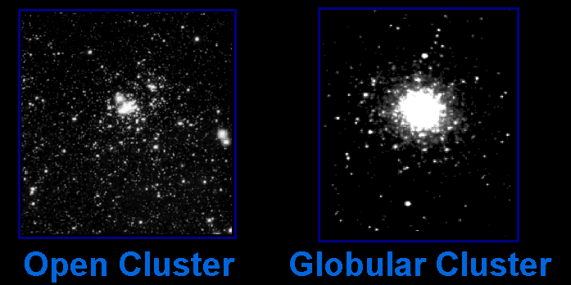
Star Clusters 101
There are two main types of star clusters in our galaxy …

Slide 9
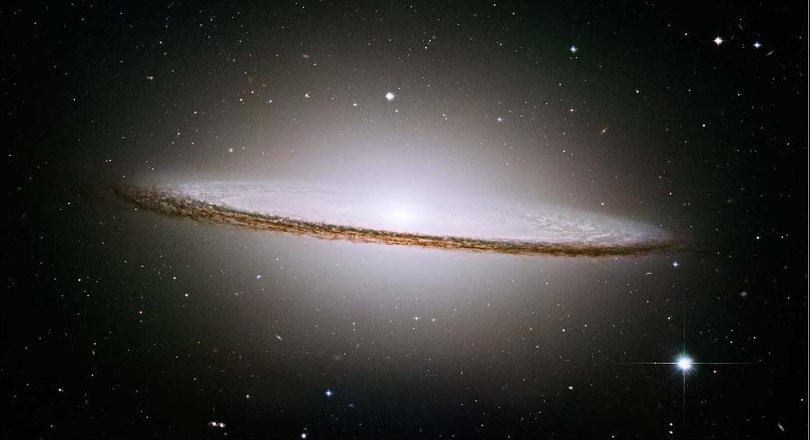
Star Clusters 101
Star Clusters 101
Open clusters orbit within the disc of the galaxy. Globular clusters orbit above and below the plane of the galaxy.
globular clusters
open clusters
halo
Central bulge
disk
disk
globular clusters

Slide 10
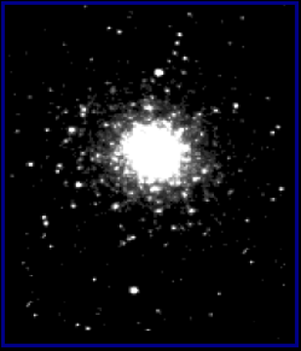

Open and Globular Star Clusters Are Different Sizes
Open Cluster
Globular Cluster
are about 30 light years across.
are about 150 light years across.
Open clusters are 5 times smaller than globular clusters. They only look the same size because they are closer.

Slide 11
Open and Globular Star Clusters Are Different Sizes
Open Cluster
Globular Cluster
have hundreds to thousands of stars.
have thousands to nearly a million stars.

Slide 12
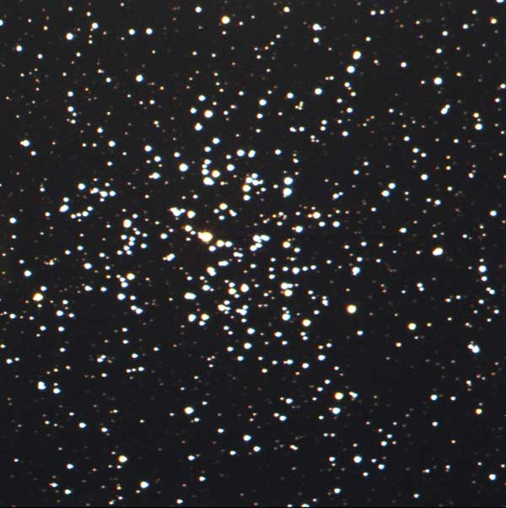
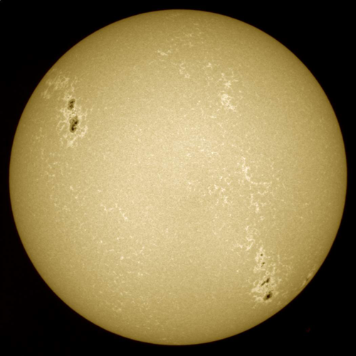
Our Sun was once part of an open cluster of stars similar to this one.

Slide 13
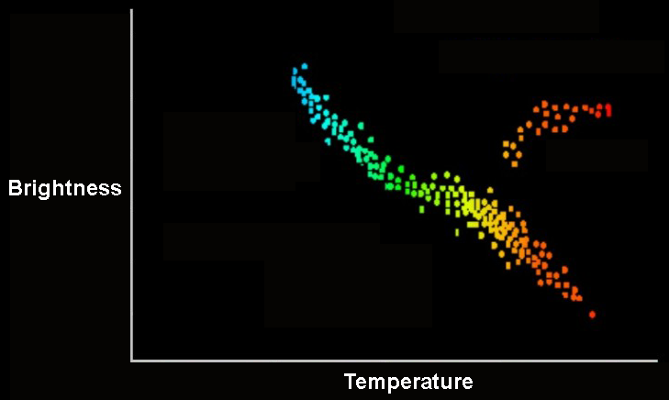
Ages of Stars
Since the stars in a cluster all form at about the same time, they give astronomers a place to test their ideas of how stars evolve.
Dying stars
Normal Stars
(main sequence)

Slide 14
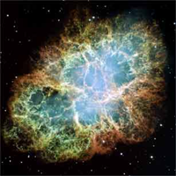
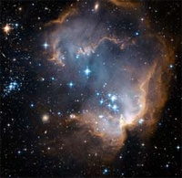
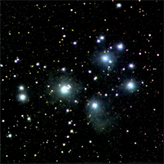
Studying Stellar Evolution
From studying groups of stars like this one, astronomers now have a pretty good understanding of stellar evolution.

